Slide 1

Introduction to Queue ADT
Dr. Tahir Maqsood

Slide 2

Outline
Queue Abstract Data Type (ADT)
Queue ADT with Array Implementation
Operations
  Insert a new element in the list
    insert at the beginning of the list
    insert at the end of the list
    insert anywhere in the list
  Delete an element from the list
    delete from the beginning of the list
    delete from the end of the list
    delete any element in the list
  Display print the elements of list

Slide 3
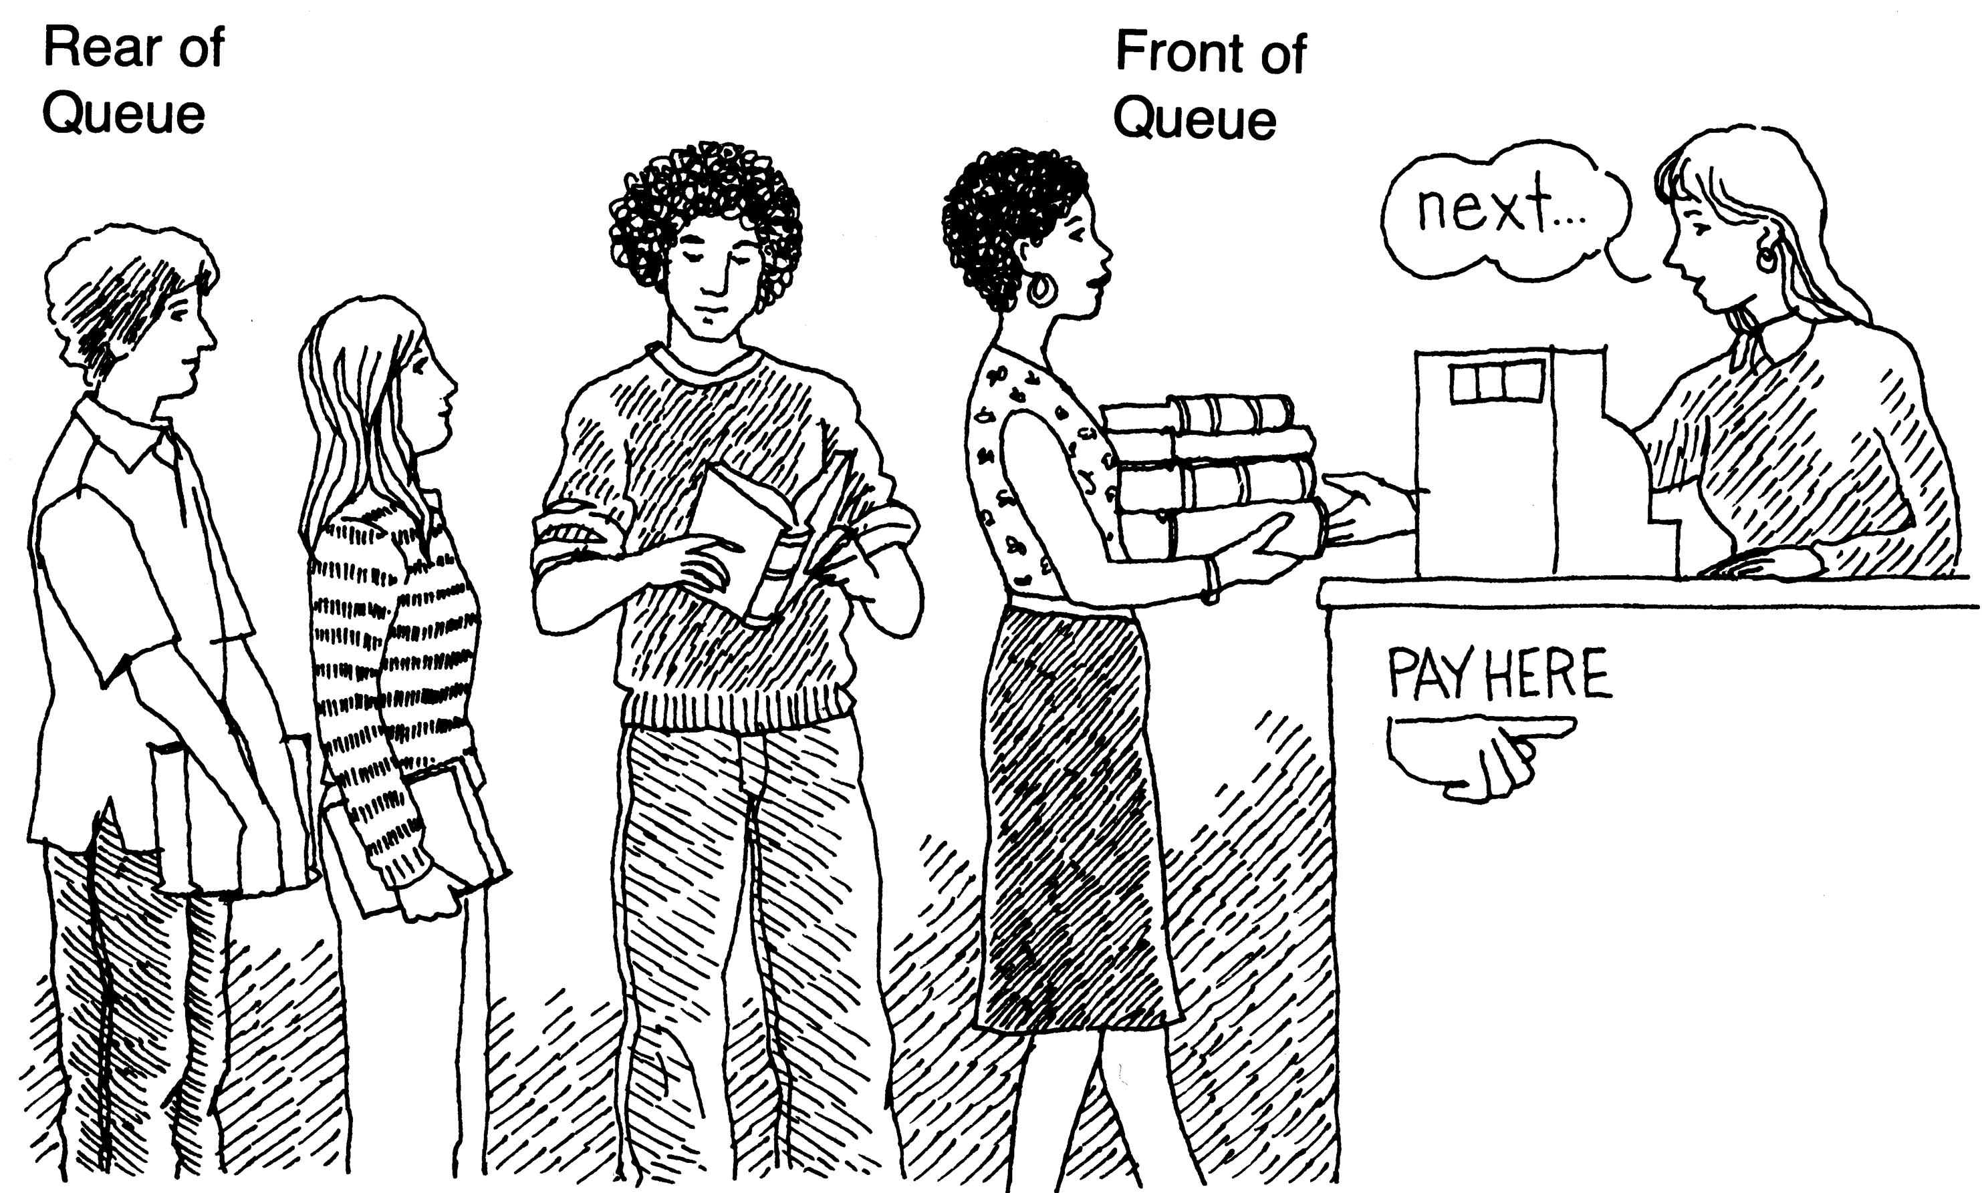
What is Queue?
It is an ordered group of homogeneous items of elements.
Queues have two ends:
  Elements are added at one end.
  Elements are removed from the other end.
The element added first is also removed first (FIFO: First In, First Out).

Slide 4
QUEUE
Upshot
A queue is a linear data structure into which items can only be inserted at rear and removed from front.
Difference between Stack and Queue
Stack | Queue
Stack is a LIFO (Last In First Out) structure | queue is a FIFO (First In First Out) structure
Stack has one end(Top) | Queues have two ends(Front and Rear)

Slide 5

Examples
For example, we queue up while depositing a utility bill or purchasing a ticket. The objective of that queue is to serve persons in their arrival order; the first coming person is served first. The person, who comes first, stands at the start followed by the person coming after him and so on. At the serving side, the person who has joined the queue first is served first.
teller 1
teller 2
teller 3
teller 4

Slide 6
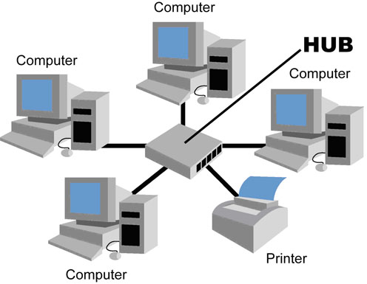
Example
  Example 2: Suppose there are four computers and one printer is connected. Computer B send print at time 9:30 am which takes 15 minutes for printing, Computer D send print command at time 9:35 which takes 7 minutes, computer A send print command at 9: 36 which takes 2 minutes and computer C send print command at 9:37 which takes 30 seconds. How printers organized these jobs in its buffer?
  In which order
  job will prints?

Slide 7
Queue Specification
Definitions: (provided by the user)
  MAX_ITEMS: Max number of items that might be on the queue
  ItemType: Data type of the items on the queue
Operations
  MakeEmpty
  Boolean IsEmpty
  Boolean IsFull
  Enqueue (ItemType newItem)
  Dequeue (ItemType& item)

Slide 8
Enqueue
Signature: Enqueue (ItemType newItem)
Function: Adds newItem to the rear of the queue.
Preconditions: Queue has been initialized and is not full.
Postconditions: newItem is at rear of queue.

Slide 9
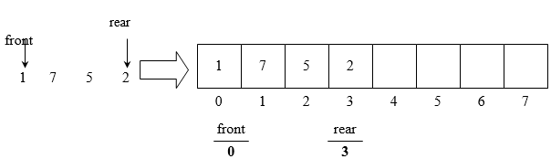
Working of enqueue()
In the above figure, queue implementation using array is shown.
As the array size is 8, therefore, the index of the array will be from 0 to 7.
The number of elements inside array are 1, 7, 5 and 2, placed at start of the array.
The front and rear in this implementation are not pointers but just indexes of arrays.
front contains the starting index i.e. 0 while rear comprises 3.

Slide 10
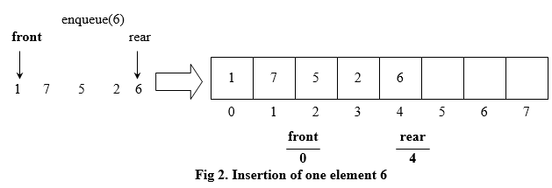
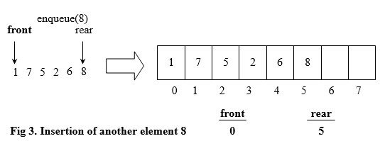
Working of enqueue()

Slide 11
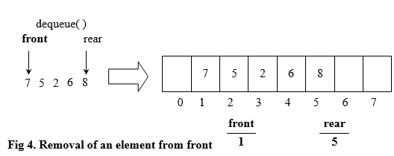
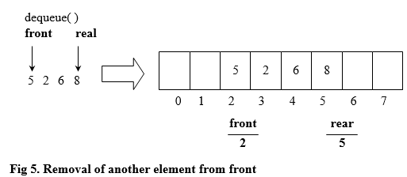
Working of enqueue()
When an element is removed from the queue. It is removed from the front index.
After another call of dequeue() function:

Slide 12
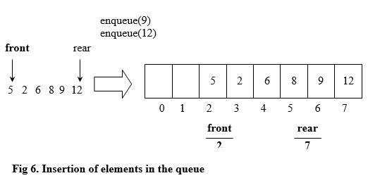
Working of enqueue()
With the removal of element from the queue, we are not shifting the array elements. The shifting of elements might be an expensive exercise to perform and the cost is increased with the increase in number of elements in the array. Therefore, we will leave them as it is.

Slide 13

Insertion Operation
After insertion of two elements in the queue, the array that was used to implement it, has reached its limit as the last location of the array is in use now.
isFull() returns true if the number of elements (noElements) in the array is equal to the size of the array. Otherwise, it returns false.
It is the responsibility of the caller of the queue structure to call isFull() function to confirm that there is some space left in the queue to enqueue() more elements.

Slide 14
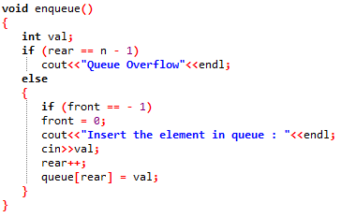
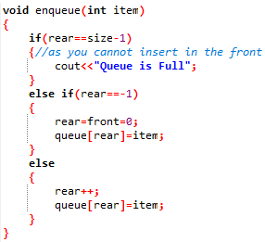
enqueue()

Slide 15
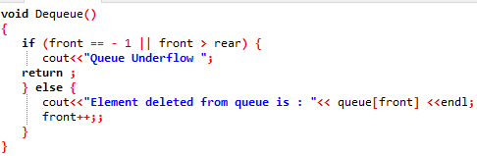
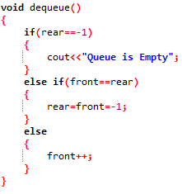
dequeue( )

Slide 16
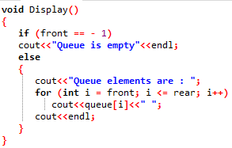
display( )

Slide 17
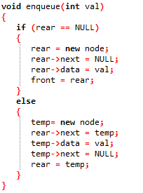
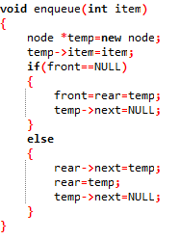
enqueue( )

Slide 18
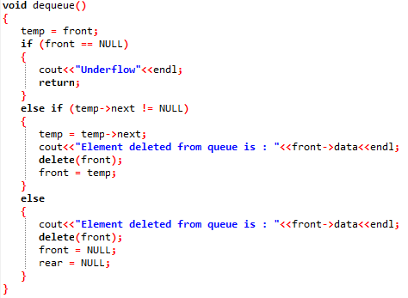
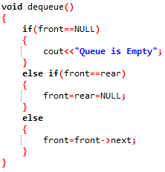
dequeue( )

Slide 19
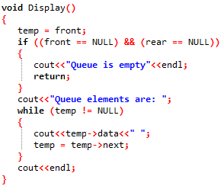
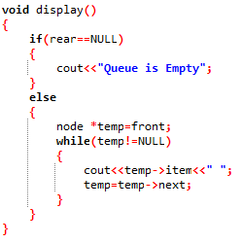
display( )

Slide 20
Array Implementation of Queues
To Enqueue an element X, we increment Size and Rear, then set Queue[Rear]=X.
To Dequeue an element, we set the return value to Queue[Front], decrement Size, and then increment Front.
Whenever Front or Rear gets to the end of the array, it is wrapped around to the beginning. This is known as a circular array implementation.

Slide 21
Circular Queues
The simple array implementation of queue has a problem
  It is wasting space
  Because front is moving towards back and leaving empty space behind.
  Elements are stored towards end of array and front cells may be empty due to dequeue
To resolve this problem array can be used as a circular array.
When we reached at end of array, start from beginning
Whenever Front or Rear gets to the end of the array, it is wrapped around to the beginning. This is known as a circular array implementation.

Slide 22

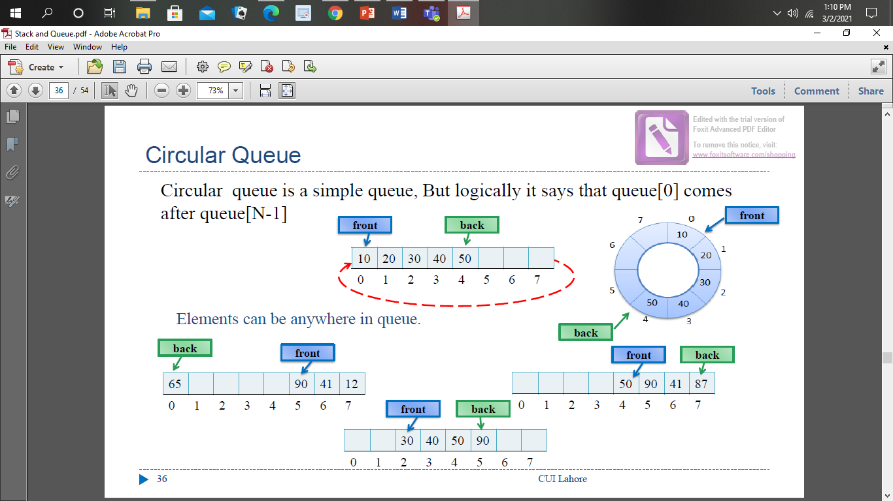
Circular Queue

Slide 23
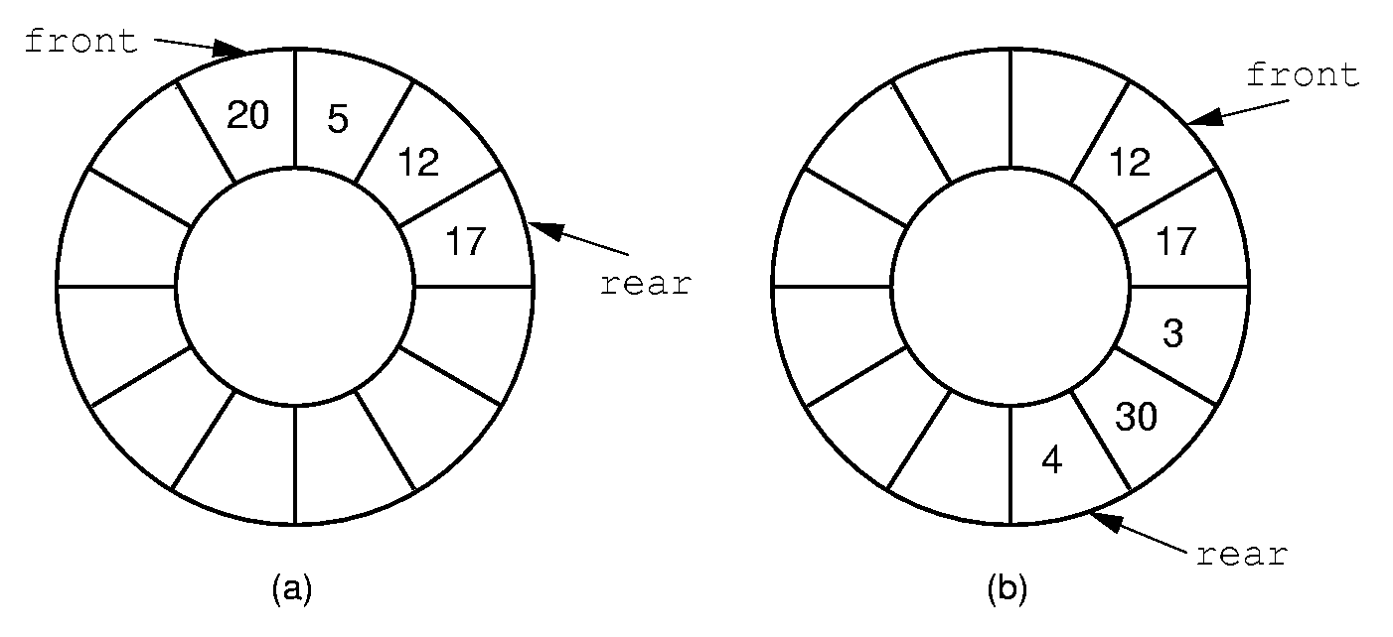
Queue Implementation (2)
Notes:
By using the mod function, we can easily achieve the effect of a “circular” queue.
This leaves one more issue. Where do the front and rear pointers go (point to the item? Or to the space before/after the item)? And, how do we distinguish a full from an empty queue?
Given a fixed position for the front element (and its pointer), there are n-1 possible states for the queue (0 through n elements in the queue for an array of size n), but only n possible positions for rear. To solve this dilemma, we must either leave an empty slot in the queue, or use and external variable to determine if the queue is empty or not.

Slide 24
Circular Array Q Data Structure
enqueue(Object x) {
  Q[back] = x ;
  back = (back + 1) % size }
Q
0
size - 1
b
c
d
e
f
front
back
How test for empty list?
How to find K-th element in the queue?
dequeue() {
  x = Q[front] ;
  front = (front + 1) % size;
  return x ; }
Notes:
Here is a data structure implementation of the Q.
The queue is stored as an array, and, to avoid shifting all the elements each time an element is dequeued, we imagine that the array wraps around on itself.
This is an excellent example of how implementation can affect interface: notice the “is_full” function.
There’s also another problem here. What’s wrong with the Enqueue and Dequeue functions?
Your data structures should be robust! Make them robust before you even consider thinking about making them efficient! That is an order!

Slide 25
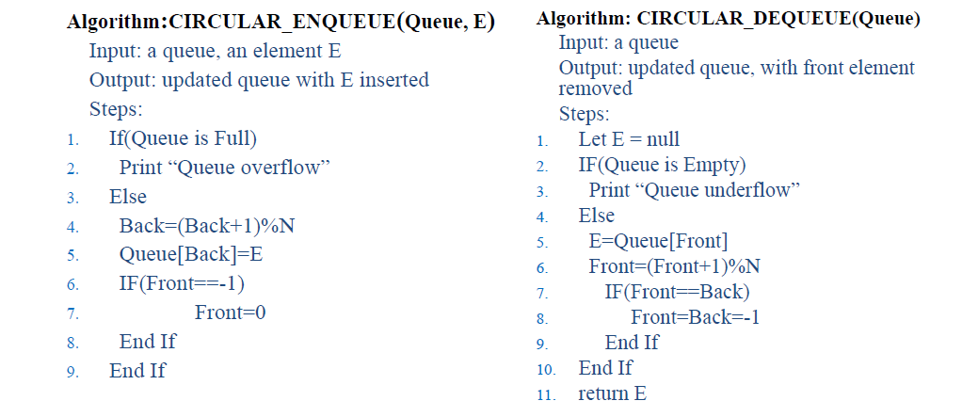
Algorithms

Slide 26
Helper Functions
Helper Methods | Queue | Circular Queue
isEmpty() | front, back = -1 | same
isFull() | back+1= N | (back+1)%N= front
Size() | back-front + 1 | (N-front+back)%N + 1 If front<back back-front + 1 Else (N-front) +(back+1)

Slide 27
Example Applications
When jobs are submitted to a printer, they are arranged in order of arrival.
Every real-life line is a queue. For instance, lines at ticket counters are queues, because service is first-come first-served.
A whole branch of mathematics, known as queueing theory, deals with computing, probabilistically, how long users expect to wait on a line, how long the line gets, and other such questions.

Slide 28
Priority Queue
Imagine a ticket window at Daewoo Terminal, the person who arrives first will get the ticket before the person who arrives later.
Now imagine process queue for CPU, ideally it should execute the process whose request was arrived first, but some time situation arise when a component/process raise request that is of highest priority and needs to be executed first regardless of the order of arriving in process queue, like computer shut down
That is the case where we need a queue which can handle priority.

Slide 29
Priority Queue
A priority queue is a collection of zero or more items, associated with each item is a priority.
In a normal queue the enqueue operation add an item at the back of the queue, and the dequeue operation removes an item at the front of the queue.
In priority queue, enqueue and dequeue operations consider the priorities of items to insert and remove them.
Priority queue does not follow "first in first out" order in general.
The highest priority can be either the most minimum value or most maximum
we will assume the highest priority is the minimum.

Slide 30
Priority Queue as ADT
Operations:
Enqueue(E)
Dequeue(): remove the item with the highest priority
Find() return the item with the highest priority
Examples
Process scheduling
  Few processes have more priority
Job scheduling
  N Jobs with limited resources to complete Patients treatment in emergency

Slide 31
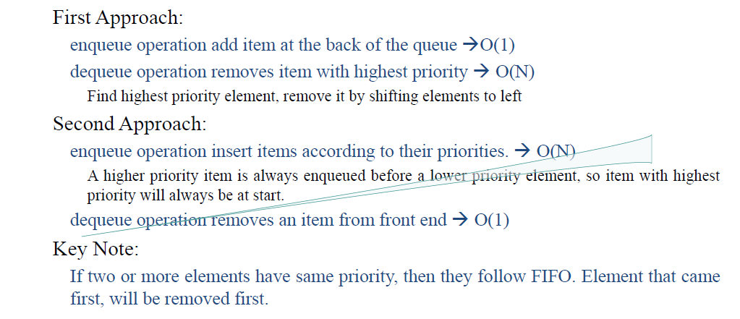
Priority Queue as ADT

Slide 32




First Approach
Enqueue(3)Enqueue(1) Enqueue(5) Enqueue(7) Enqueue(4) Enqueue(2)
Dequeue()
Find highest priority 2
Back=5
Back=3
3
1
5
7
4
2
3
5
7
4
Dequeue()
Find highest priority 1

Move to left
Back=4
Back=3
3
5
7
4
2
5
7
4

Slide 33
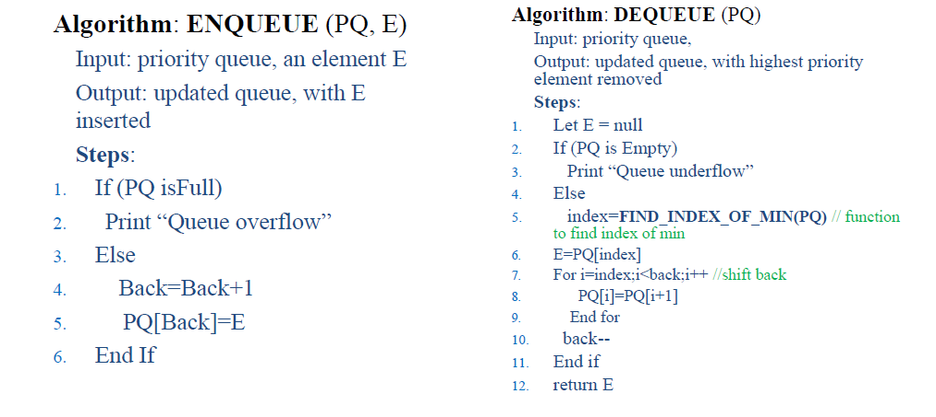
Algorithms

Slide 34
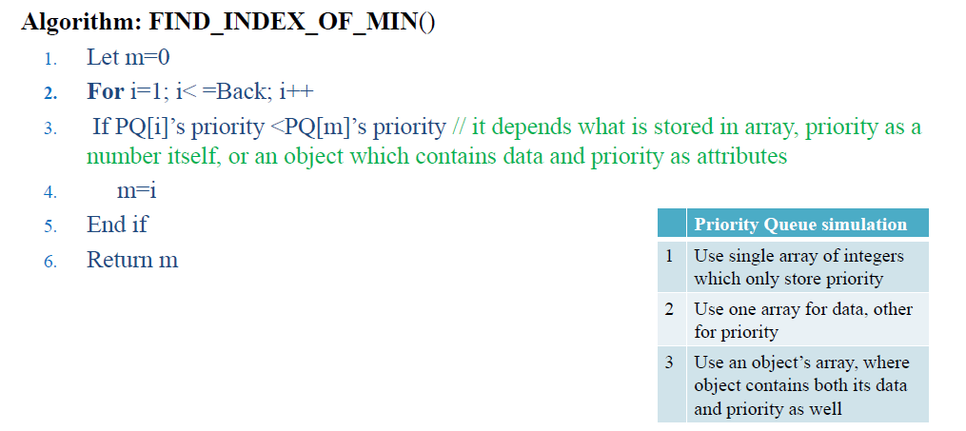
Algorithms

Slide 35
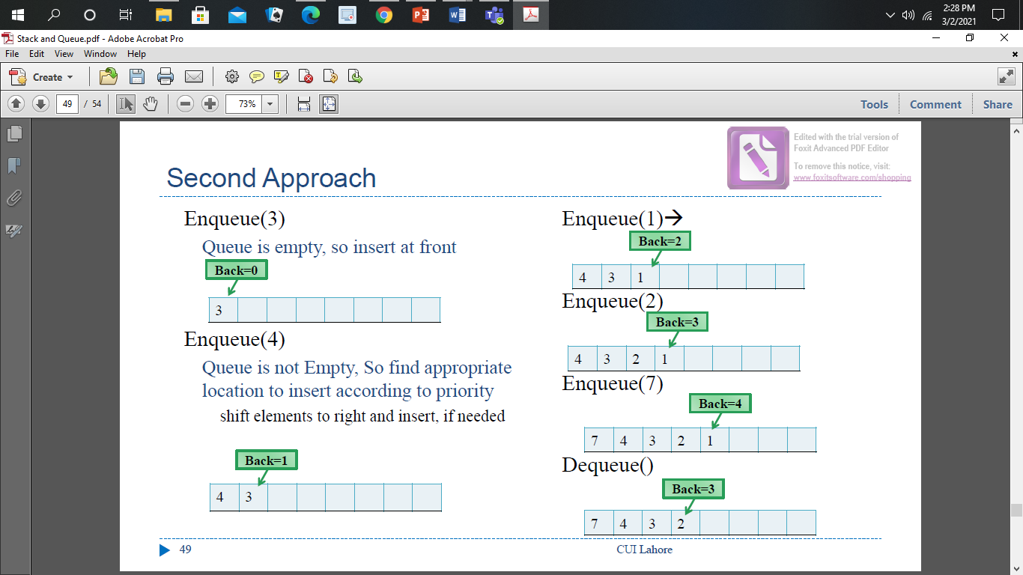
Second Approach

Slide 36
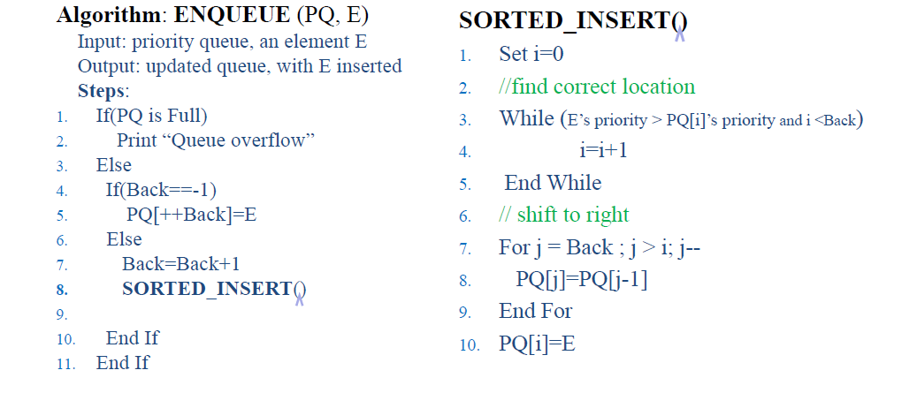
Algorithm

Slide 37
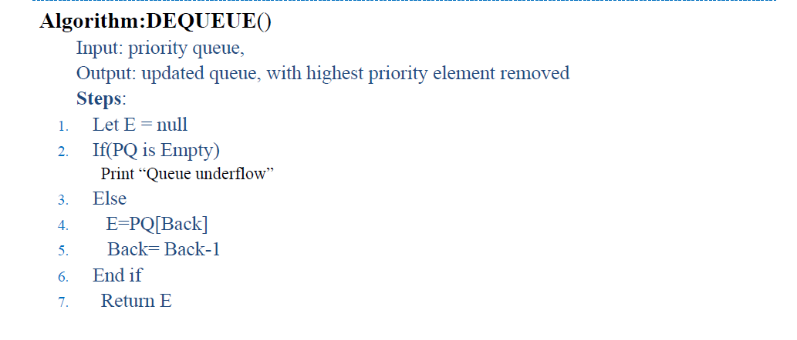
Algorithm

